Slide 1


Slide 2
Review
HTML
<!DOCTYPE HTML>
<html>
<head>
<title>
<body>
<h1>
<p>
<b>
<u>
<i>

Slide 3
Styling in tag
Background Color
Color of text
Aligning

Slide 4

Using STYLE

Slide 5
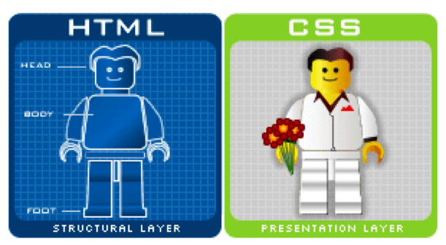

Slide 6

What is CSS?
CSS stands for Cascading Style Sheets
CSS is a language that describes the style of an HTML document.
CSS describes how HTML elements should be displayed.

Slide 7


External CSS file
Using CSS file with <link> tag

Slide 8

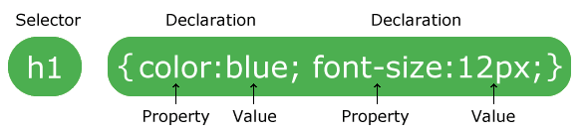
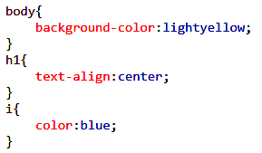
CSS Syntax
Example

Slide 9

CSS Styles
CSS Style | Description | Example
color | Color of text | color: blue
background-color | Background Color of element | Background-color:Tomato
font-family
font-size
border | Set border: width style color | Border: 1px solid blue
padding | Used to generate space around an element’s content. Inside of border | Padding: 30px;
margin | Used to create space around Elements. Outside of border. (top, right, bottom, left) | Margin: 25px

